Slide 1
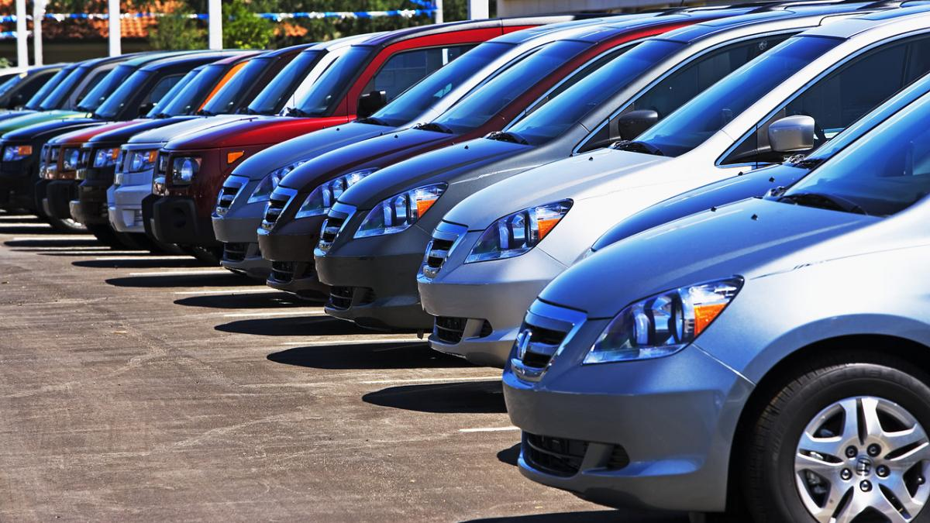
Mini Project on Used Cars Data

Slide 2
Agenda
Introduction
Data Cleaning/ Data Manipulation
Feature Engineering
Exploratory Data Analysis
Statistical Analysis
Conclusion

Slide 3
Introduction

Slide 4
About the Project
There is a huge demand for used cars in the US Market today.
As sales of new cars have slowed down in the recent past, the pre-owned car market has continued to grow over the past years and is larger than the new car market now. XYZ is a budding automobile company that aspires to enter the Used-car market by setting up their company locally to give competition to their counterparts.
Some car sellers replace their old cars with pre-owned cars instead of buying new ones. Used cars are very different beasts with huge uncertainty in both pricing and supply.
Keeping this in mind, the pricing scheme of these used cars becomes important in order to grow in the market. We have to come up with a pricing model that can effectively predict the price of used cars and can help the business in devising profitable strategies using differential pricing.

Slide 5
Problem Statement
The goal of this project is to estimate the price of used carsin the USA, using various statistical and exploratory data analysis techniques.
For the benefit of buyer and sellers, a predictive analysis on used cars prices and an estimation of what would be a good price to sell a car on the open market.
Try to make an estimate as to what features of a car matters the most, in determining used car’s pricing.

Slide 6
Objective
The objective of the project is to discuss the features of used-car with regard to its influence on the market price. Based on such analysis, a model for price prediction could be constructed in order to provide a real-time used-car evaluation service. The final product takes features (transmission, owner, fuel, seller_type,etc) of a used-car as input and output a prediction of price.
Moreover, it should be capable of producing an interval prediction as price range, and it should be able to handle missing features so that the user can make a query even when they are not clear about certain feature. As a more ambitous attempt, a recommender system could be build such that we can not only evaluate the price, but also recommend features for car search by the potential buyers, based on the expected price and desired features.

Slide 7
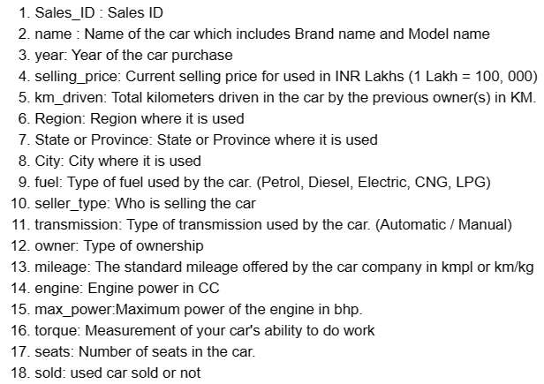
Dataset Description

Slide 8
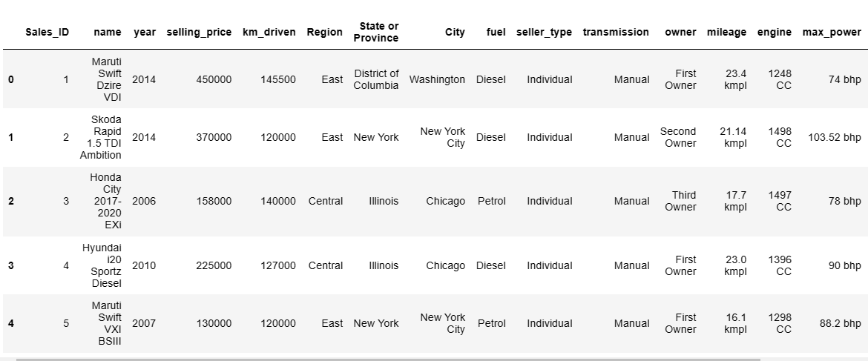
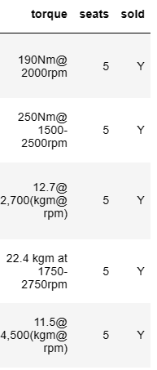
Dataset
Obtained 7906 rows and 18 columns from the dataset

Slide 9
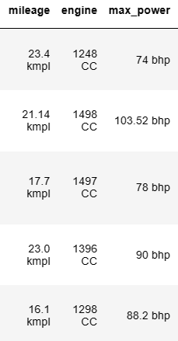
Data cleaning
Inside column details like symbols, kilomaters (kmpl), CC and bhp words are removed for each row

Slide 10
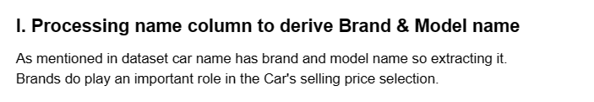
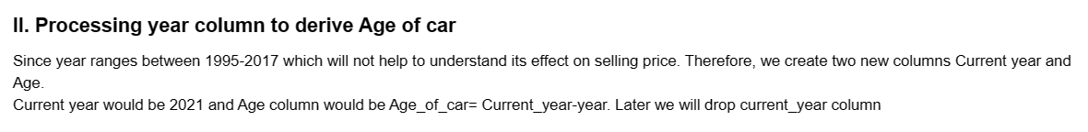
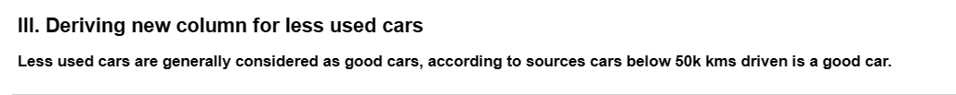
Feature Engineering

Slide 11
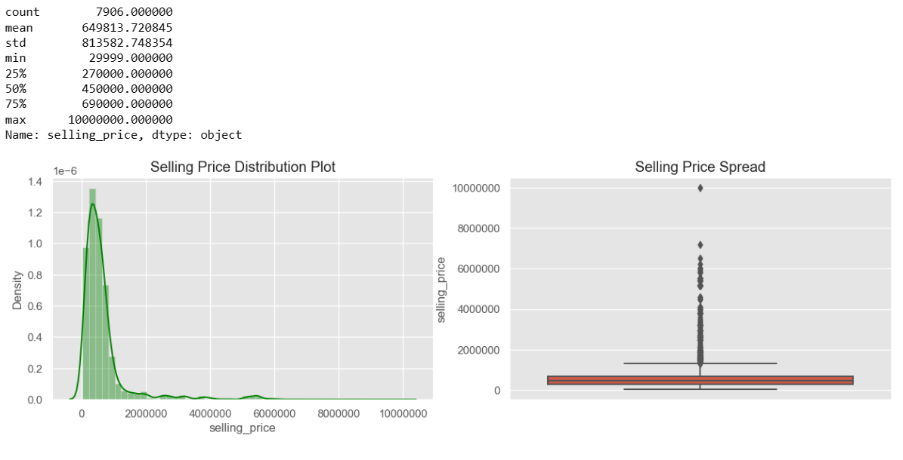
Exploratory Data Analysis

Slide 12
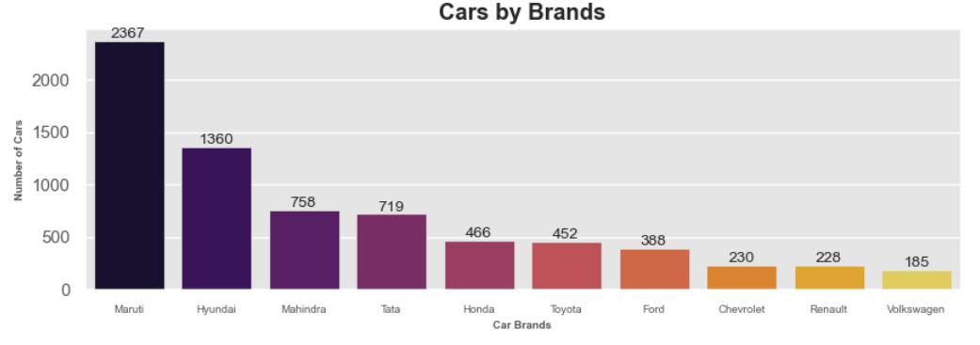
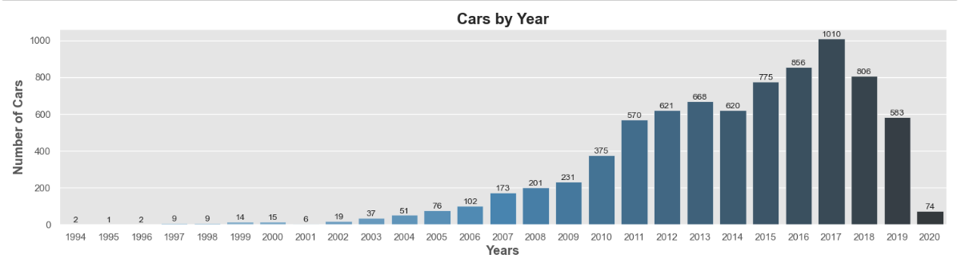
Exploratory Data Analysis..Contd..

Slide 13
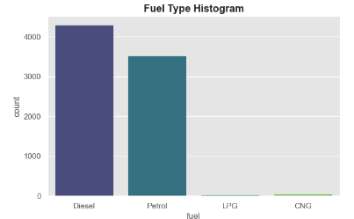
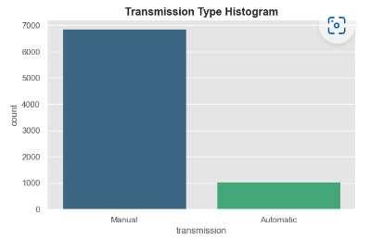
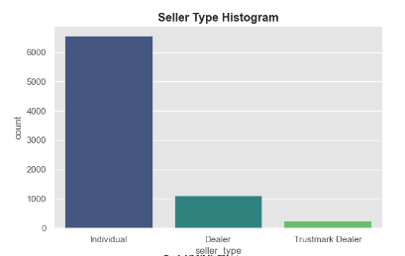
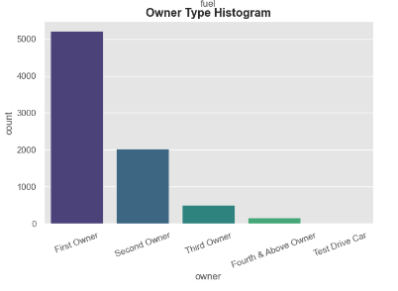
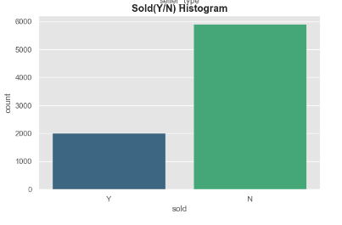
Exploratory Data Analysis..Contd..

Slide 14
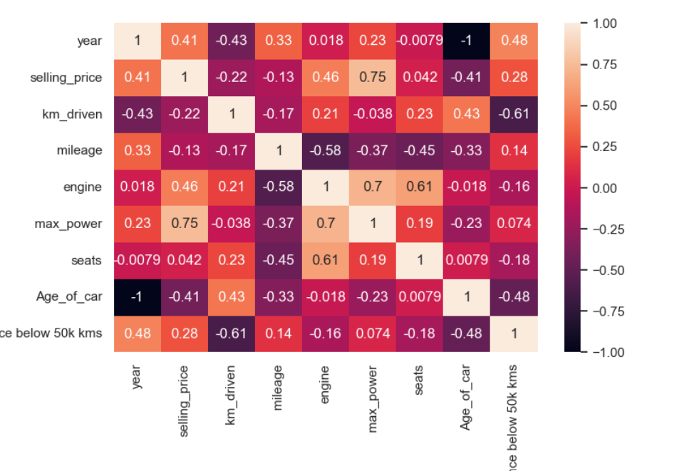
Exploratory Data Analysis..Contd..

Slide 15
Exploratory Data Analysis..Contd..
**Observations from the analysis**
- The analysis indicates that the most significant predictors of price of used cars are -
-Age of the car
-Number of seats in the car
-Power of the engine
-Mileage
-Kilometers Driven
-Location
-Fuel_Type
-OwnerType
-Transmission - Automatic/Manual
-Newer cars sell for higher prices.

Slide 16
Exploratory Data Analysis..Contd..
-As the number of seats increases, the price of the car increases.
-Mileage is inversely correlated with Price. Generally, high mileage cars are the lower budget cars.
-Kilometers Driven have a negative relationship with the price which is intuitive. A car that has been driven more will have more wear and tear and hence sell at a lower price, everything else being 0.
-The categorical variables are a little hard to interpret. But it can be seen that all the car_category variables in the dataset have a negative relationship with the Price and the magnitude of this negative relationship decrease as the brand category moves to lower brands.

Slide 17
Thank You

